Slide 1
EMS Reports
Crystal Hamilton

Slide 2
Agenda:
My Views
Set up worksheet
Event schedule
Resource schedule
Query builder
Browser
Calendar
LIVE DEMO
Notes:
There are over 110 EMS pre reports
Over 90 automated reports are sent out from the system.. Daily, weekly, biweekly, monthly and everything in between

Slide 3
My Views
A great way to pull multiple spaces across one or more building.
Great when you don’t want to see all of the spaces in a Building or Area
User account specific. ONLY SEEN BY YOU. No one else with system access can see.
Use Cases: Monitor the use of certain spaces you oversee
Notes:
Monitor the use of certain spaces you oversee for example, when I was point or Reunion Weekend, I created a View that contained all of the rooms Reunion used so if I received a call I could quickly spot or move to another space.

Slide 4
Setup Worksheet
Most common report on campus.
Generally the best all around report includes: services, event information, first contact information, reserved and event time information.
Customizable to only show certain categories if desired.
Support Services gets a daily report that only has the Support Services related categories, no Dining, no TMSS, etc.
Notes:
- Gives the most information regarding the event. If you have it configured to list Dining Services, or Support Services information, it will all display.

Slide 5
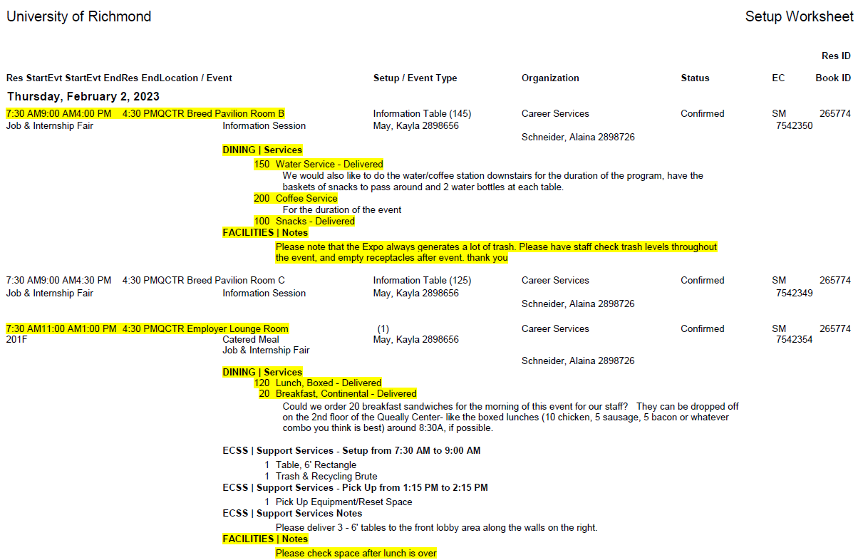
Notes:
Specially formatted version Setup Worksheet of the weekly campus Operations Report

Slide 6
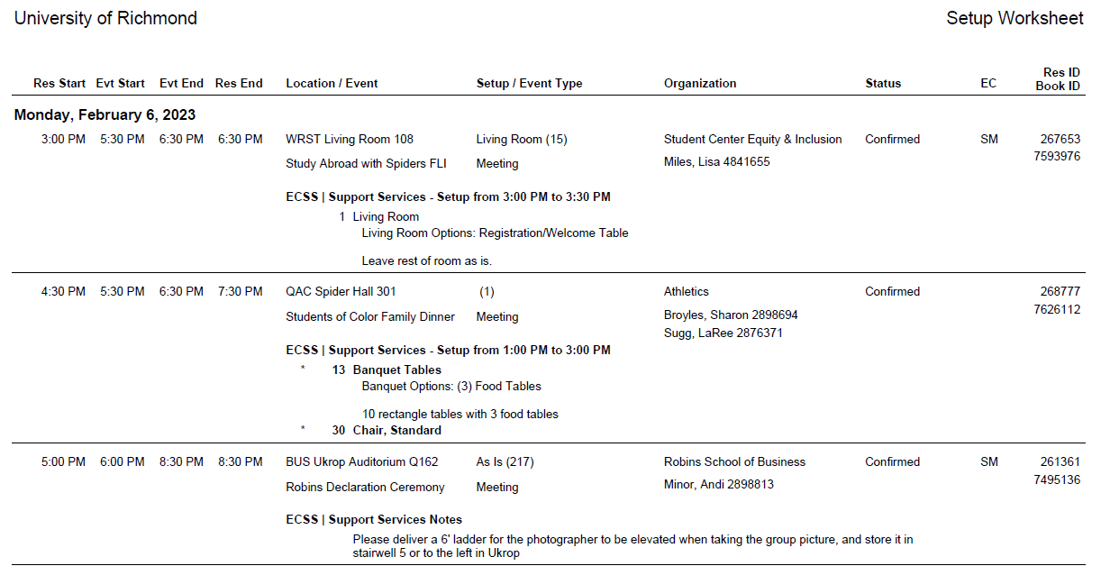
Notes:
The Setup Worksheet the Support Services staff receive every morning. It only displays bookings that have the ECSS | Support Services categories.

Slide 7
Event Schedule
Gives start & end time, organization, event name and location.
Great for front desks or to post on door of space(s)
Notes:
- Places where not a lot of information is needed; where a quick list of what’s happening would be helpful for conference rooms,
- CSI receives reports of their daily vans, Custodial receives one for Thailmer cottage

Slide 8
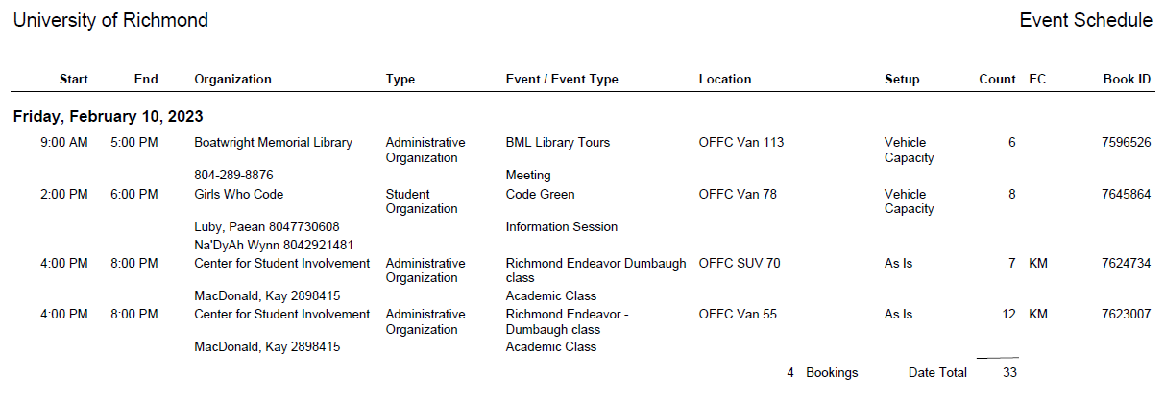
Notes:
This is the event schedule CSI receives daily with the vehicles that will be in use.

Slide 9
Resource Schedule
Used to easily see at a daily glance which resources are requested.
Category based (ie. Dining Services, Support Services, TMSS, URPD Event Services)
Use Cases: Great for seeing daily quantities needed.

Slide 10
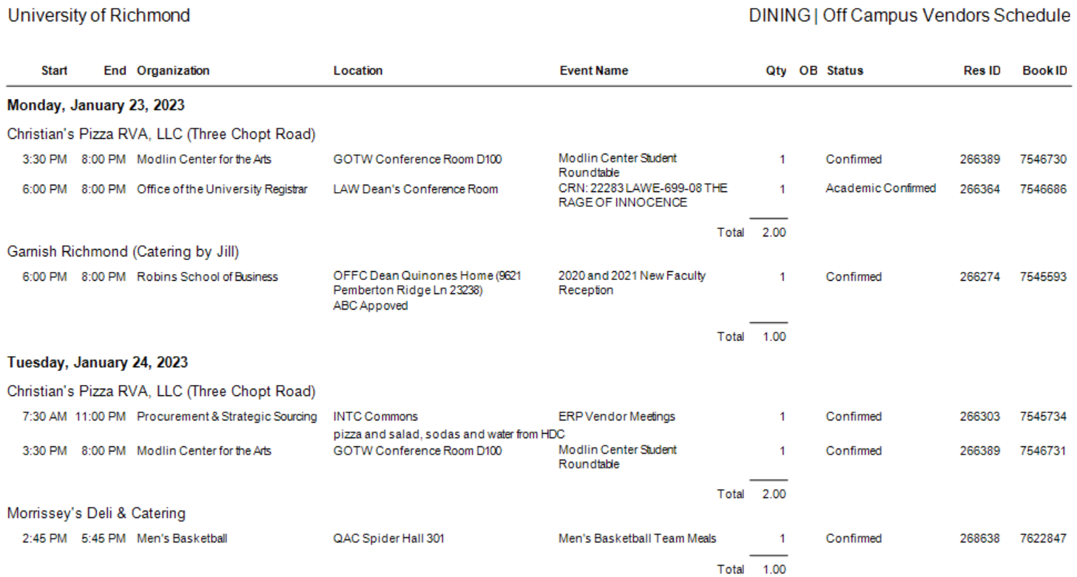
Notes:
I use this when the new approved vendors list comes out. I use it to get a quick look to see if any event holders need to be alerted if the vendor has fallen off the list.

Slide 11
Query Builder
Highly customizable to pull information for various aspects of the system.
You can customize what is displayed, how the data is sorted, what data is filtered in or out.
Use Cases: When you want specific or particular information, especially information other report types lack

Slide 12
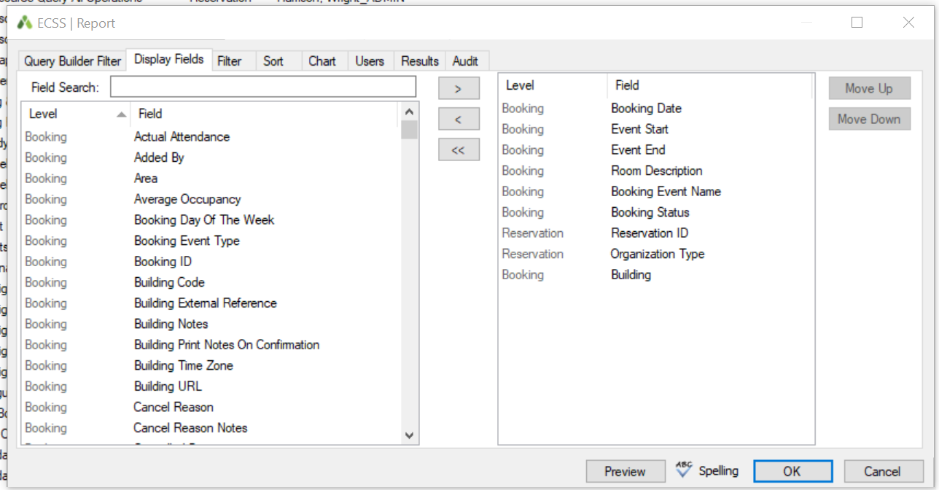
Notes:
The query builder allows you to choose which fields you want to display and where you want them positioned.

Slide 13
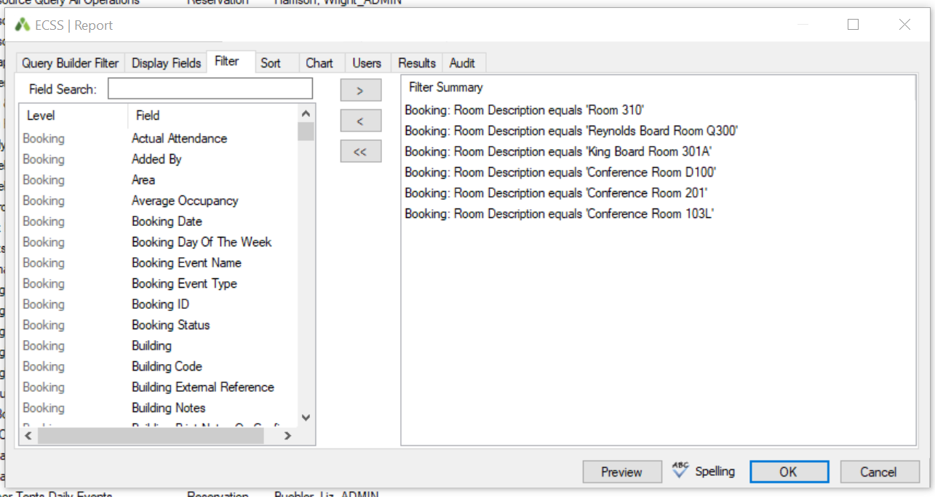
Notes:
You can filter out by fields from the system.

Slide 14
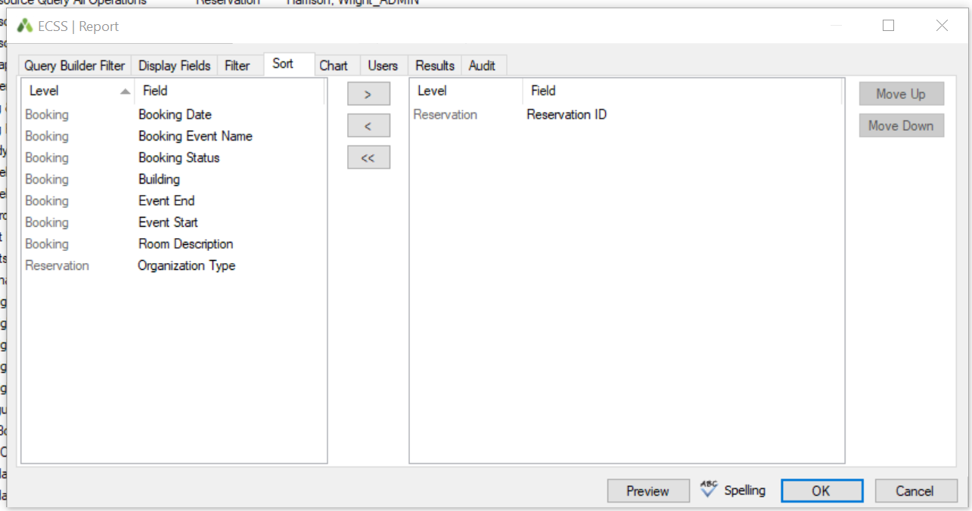
Notes:
You can sort the results by any field you chose to display.

Slide 15
Browser
My best friend and most used way to pull information :)
Technically not considered a report but is similar to the Query Builder but more user friendly
Notes:
Helpful to help people find the reservation they are looking for… Maybe it wasn’t put in the Web App and the everyday user and Process template weren’t added to the reservation so they can’t see it online. This is a department that has tons of reservations
Helpful if someone needs a list of events happening in your area and they don’t’ need much other details.

Slide 16
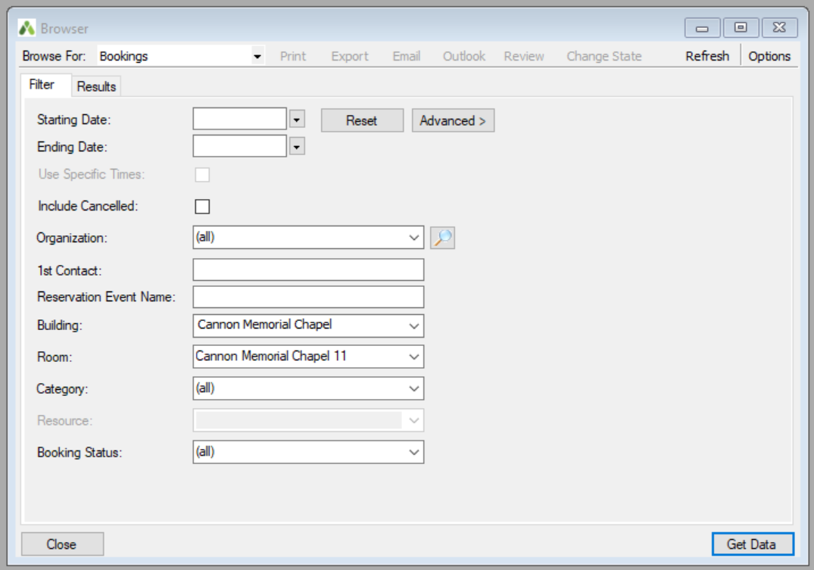
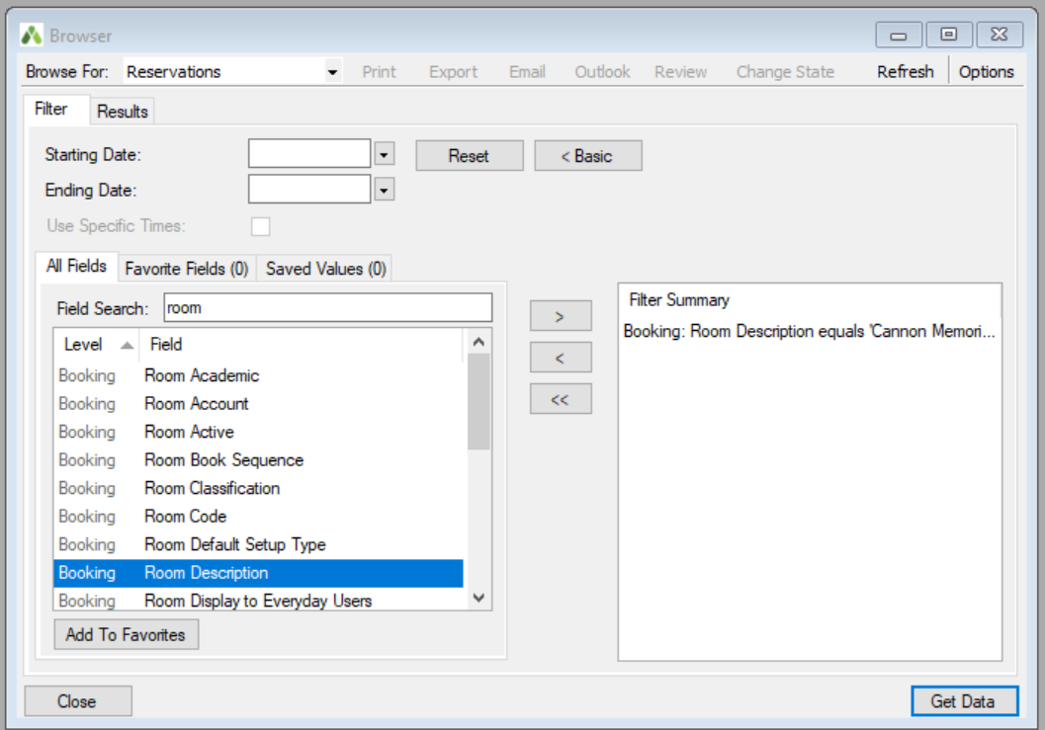
Notes:
The top left is the Basic format and if you click the word “Advanced” you will see the bottom right which is the Advanced format. It is similar to filtering in the Query.

Slide 17
Calendar
Honorable Mention!
A visual snapshot of the volume in a month’s time.
Use Cases: Searching to see what is occurring in a building/space during the month
Notes:
Example: Facilities wants to know when they can do work in a particular area of your building

Slide 18
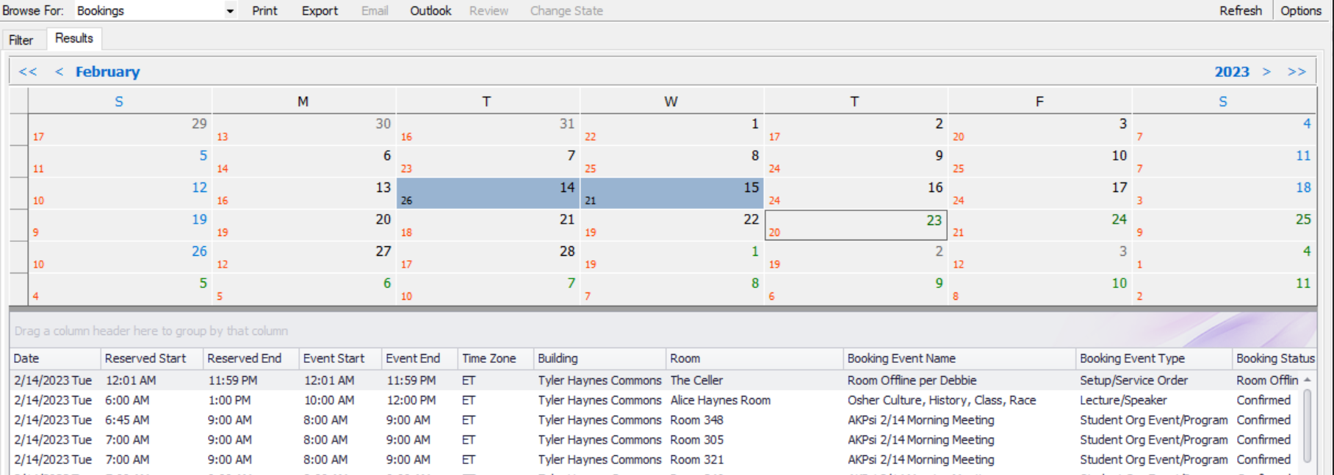
Notes:
You can choose multiple dates to display and then print a list or export an Excel with the data.

Slide 19
Live demo

